Slide 1
Real World Engineering Complex projects design
Ilan Be’ery, Rafael
MICE conference 2019

Slide 2

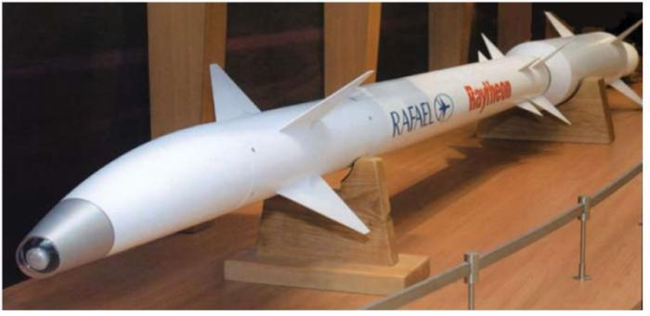

Rafael is a medium-size defense company with an annual revenue of 10¹⁰ NIS/year
Rafael has specialized in cutting-edge technology and revolutionary systems for over 60 years.

Slide 3
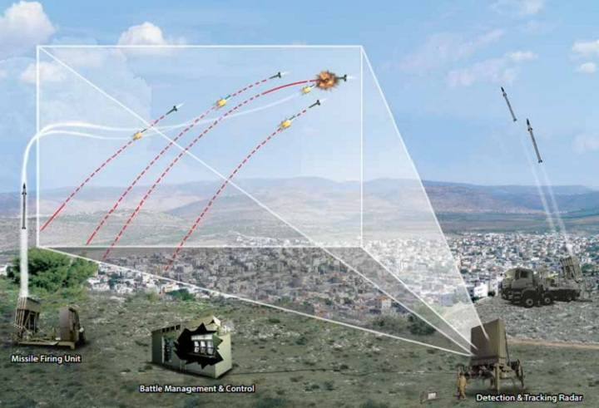

The Iron dome example:
800 million NIS and 2.5 years from idea to a working system.
This is a relatively cheap and very short security project!
Such large scale projects require careful design and decision-making methodology, which is why Rafael is a world leader in system design and high risk project management.
Such large scale projects require solid, low risk, well engineered building blocks

Slide 4
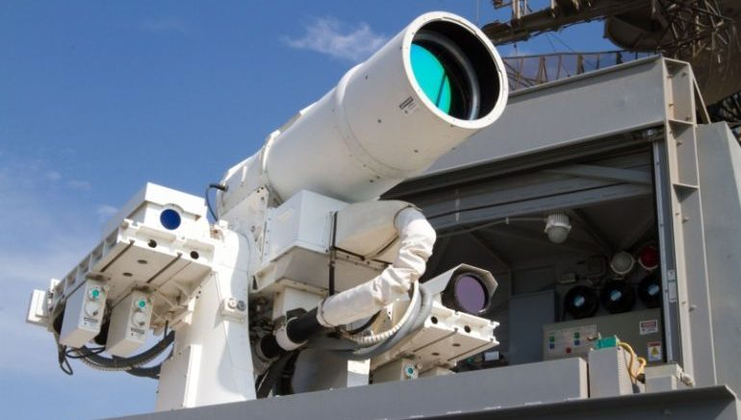

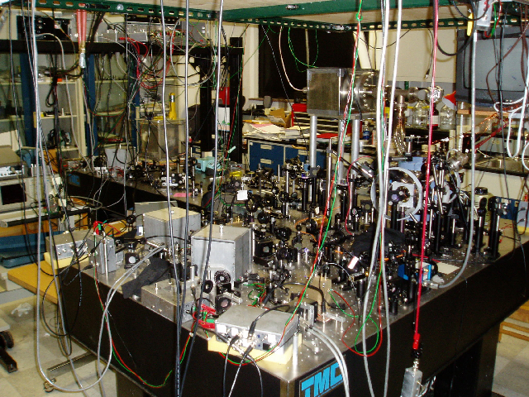
The experimental physics department
The department is specialized in R&Ding physical concepts and ideas from the conceptual and academic level into low risk building blocks for full scale development.
High power laser
High power microwave
Quantum technologies

Slide 5


‘Why do I need project design?’
You are:
Building highly complicated, state-of-the-art system
Conducting complicated experiments with varying setups
You have:
Limited money
Limited time
Limited (or no) experience in building such systems
Common outcome

Slide 6
The 101 guide of project engineering:
Think what you need
Think how to do it technically
Think about the schedule
Think what might hold you back
Act to reduce risks and delays
… and use experienced colleagues to think with you!

Slide 7
Think what you need
Think how to do it technically
Think about the schedule
Think what might hold you back
Act to reduce risks and delays
System Requirements Review (SRR)
What are the ultimate goals of the project?
Should be specific goals
Try to combine high-risk-high-gain with more humble goals
Consider ultimate goals and secondary goals
What are the required features and specifications of the system to achieve the goal?
Think deeply into the SRR and do it with your supervisor and colleagues
Beware of over-spec! It is a slippery road that might reach a dead end

Slide 8
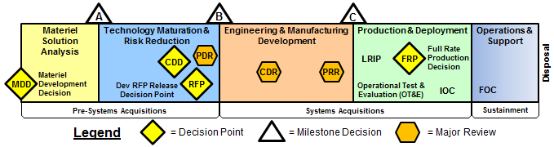
Think what you need
Think how to do it technically
Think about the schedule
Think what might hold you back
Act to reduce risks and delays
PDR – Preliminary design review
Intended mostly for concise selection between alternatives of system / component architecture
Things to consider: compliance with requirements, cost, time, performance, flexibility, utility, risks*

Slide 9
Think what you need
Think how to do it technically
Think about the schedule
Think what might hold you back
Act to reduce risks and delays
CDR – Critical design review
Intended to review the final design before manufacturing / purchasing
Things to consider: compliance to requirement, technical issues, safety, risks

Slide 10
Think what you need
Think how to do it technically
Think about the schedule
Think what might hold you back
Act to reduce risks and delays
TRR – Test readiness review
Intended to review the final system and it’s readiness for use
Things to consider: compliance to requirement, safety of operation

Slide 11
Think what you need
Think how to do it technically
Think about the schedule
Think what might hold you back
Act to reduce risks and delays
How to use reviews in research project?
Choose your reviews – they are intended for supporting complicated decisions and avoiding (some of the) mistakes
Choose your reviewers – supervisors, experienced researchers, technical experts
Get prepared - preparing the review is a good opportunity to make some order in your planes
Open your mind - Implement good advices

Slide 12
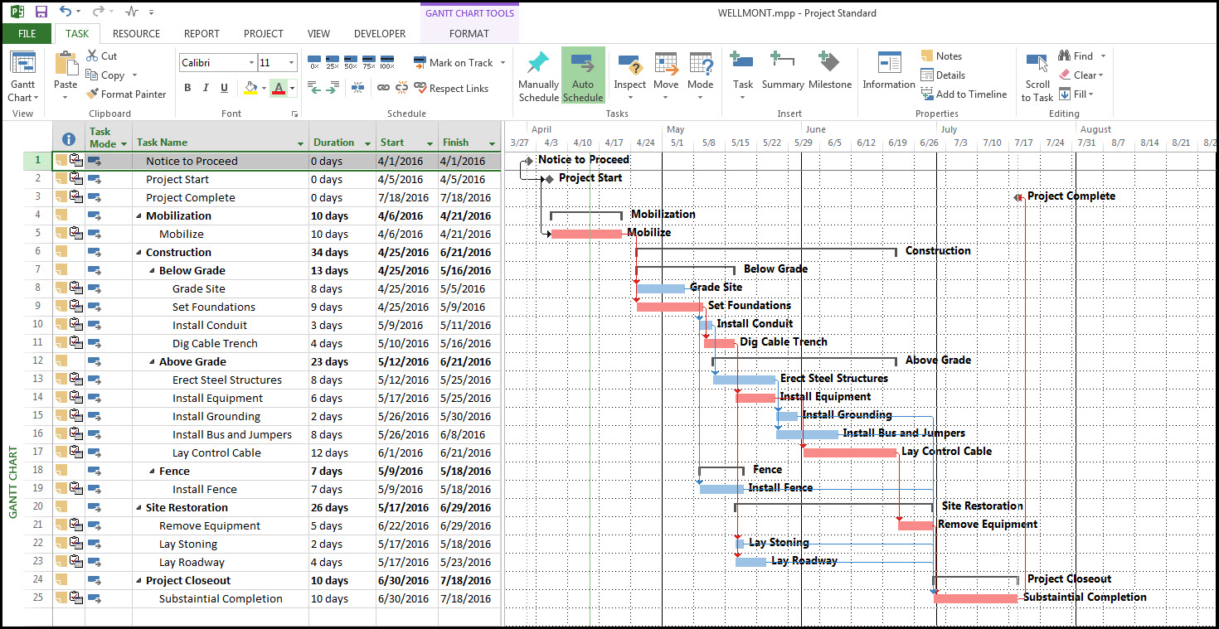
Think what you need
Think how to do it technically
Think about the schedule
Think what might hold you back
Act to reduce risks and delays
Gantt and Critical channels
Gantt is a detailed flow chart of the project with time-line and dependencies

Slide 13
Think what you need
Think how to do it technically
Think about the schedule
Think what might hold you back
Act to reduce risks and delays
Building a Gantt
There are many tools to build a Gantt:
https://www.teamgantt.com/
MS project
Powerpoint, paper & pen…
The level of details should depend on your experience – get more detailed for activities you are not familiar with
Ask for advice from experienced people
Look for dependencies – they might be crucial

Slide 14
Example: Gantt of the cold atomic trap project

Slide 15
Think what you need
Think how to do it technically
Think about the schedule
Think what might hold you back
Act to reduce risks and delays
How to use Gantt in research project?
Focus your attention on critical channels and near critical channels (but don’t forget the others)
Advise the Gantt whenever you make a decision about schedule, money and risk taking
Remember that the Gantt is always optimistic. If the schedule is marginal, be prepared for troubles
Update your Gantt once in a while and re-check the critical channels

Slide 16
Think what you need
Think how to do it technically
Think about the schedule
Think what might hold you back
Act to reduce risks and delays
Risk assessment : the Bonen scale
The risk level in the building blocks and sub-systems of the project are rated according to the Bonen scale

Slide 17
Think what you need
Think how to do it technically
Think about the schedule
Think what might hold you back
Act to reduce risks and delays
How to reduce your risks:
The ultimate goal of academic research is Bonen level 4 by definition.
You don’t want Bonen level 4 as a building block in your project
The risk of building blocks of Bonen level 3 must be reduced by:
Developing more than one alternative in parallel
Looking for help / collaboration
Making enough time in the Gantt for 3 development cycles
You want most of your building blocks at Bonen levels 1-2

Slide 18



Think what you need
Think how to do it technically
Think about the schedule
Think what might hold you back
Act to reduce risks and delays
Fast delivery suppliers are crucial resource for highly iterative research project
… However, they are not always available

Slide 19
Think what you need
Think how to do it technically
Think about the schedule
Think what might hold you back
Act to reduce risks and delays
Long Lead Items (LLIs)
LLIs might become the critical channel and cause major delays if not recognized soon enough
LLI might be:
Items with known long delivery time
Items where the manufacturer has high probability of delays
Items with high probability of re-work or non-compliance

Slide 20
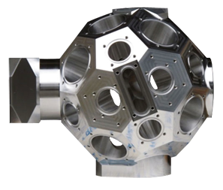
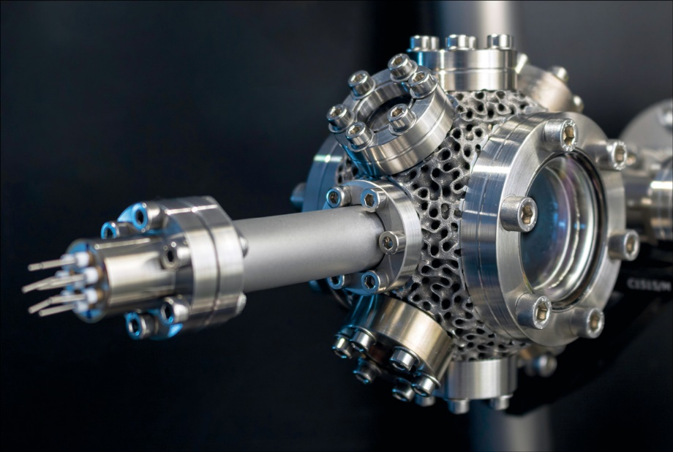
Think what you need
Think how to do it technically
Think about the schedule
Think what might hold you back
Act to reduce risks and delays
How to recognize your LLIs?
Custom-made products per your specifications
Exotic materials, technologies
Only few, small, dedicated, manufacturers
State of the art or beyond
Tends to fail, short MTBF
Look at the critical and near critical channels of the Gantt
Ask others with similar projects

Slide 21
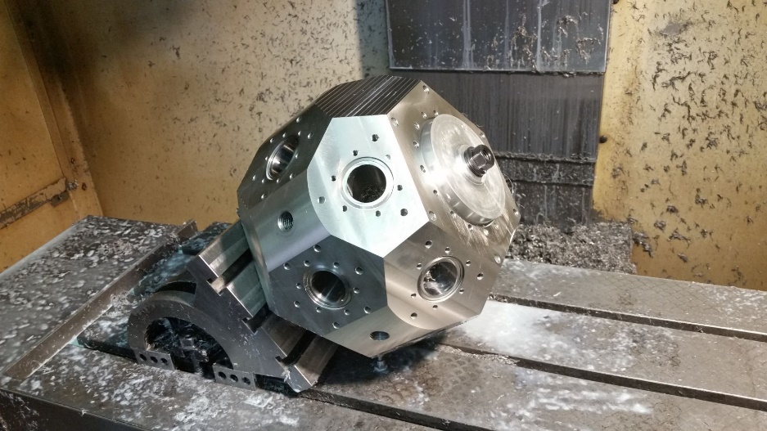
Think what you need
Think how to do it technically
Think about the schedule
Think what might hold you back
Act to reduce risks and delays
Example: LLI of the cold atomic trap project at Rafael
The researchers of the first project had two LLIs in the project:
Titanium vacuum chamber which is built to print
Optical, UHV windows, which are rather unique and the researchers had no experience with.
Delays in the manufacturing of the chamber cost the researchers a year and the windows cost them another 6 month!
For the second project, other researchers took care of the LLIs by:
Interviewing the first researchers about their difficulties
Locating alternative manufacturers and talking to costumers
Giving high priority to the design and orders of the LLIs

Slide 22
Think what you need
Think how to do it technically
Think about the schedule
Think what might hold you back
Act to reduce risks and delays
Managing LLI’s
It’s not too expensive
Buy ASAP
It’s cheap
Buy several
It’s expensive
Decide on timing according to supply schedule and optimistic Gantt

Slide 23
Conclusions:
You are doing high risk projects.
Conscious and methodical approach to high risk and complex projects increases the probability of success.
Three critical issues must be identified and managed
High risk goals (Bonen scale 3&4)
Long lead items
Critical channels
When ever you can – be conservative. Keep the novelty to where it matters.
Document the process. It will be beneficial to other researchers – even to you.

